Slide 1
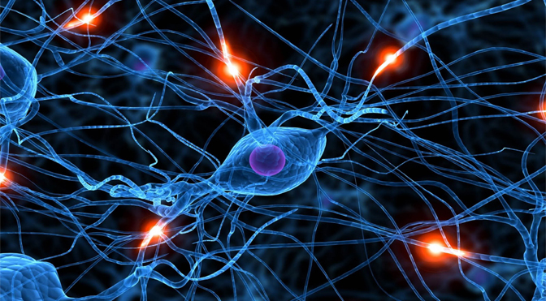
Chapter 9. Advanced Classification: Neural Networks
Meng Jiang
CSE 40647/60647 Data Science Fall 2017
Introduction to Data Mining

Slide 2
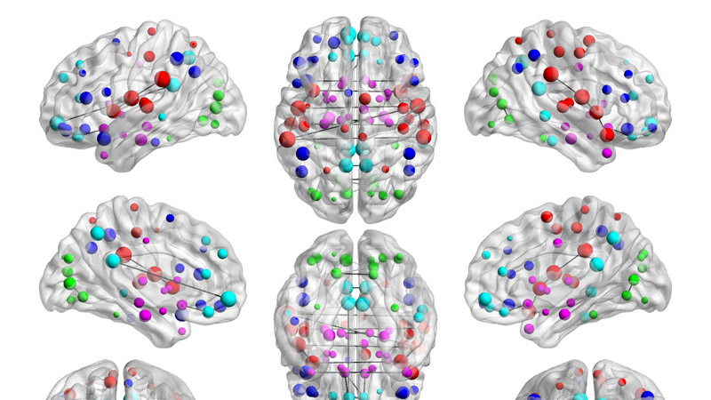
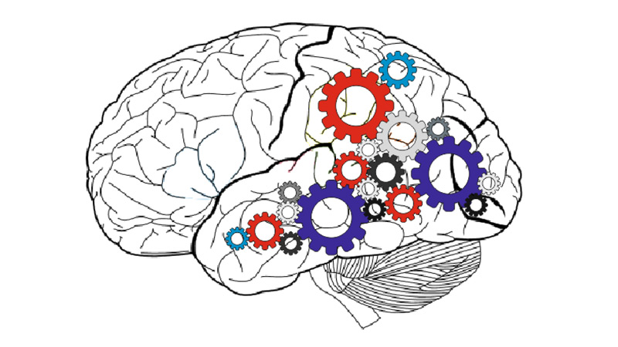
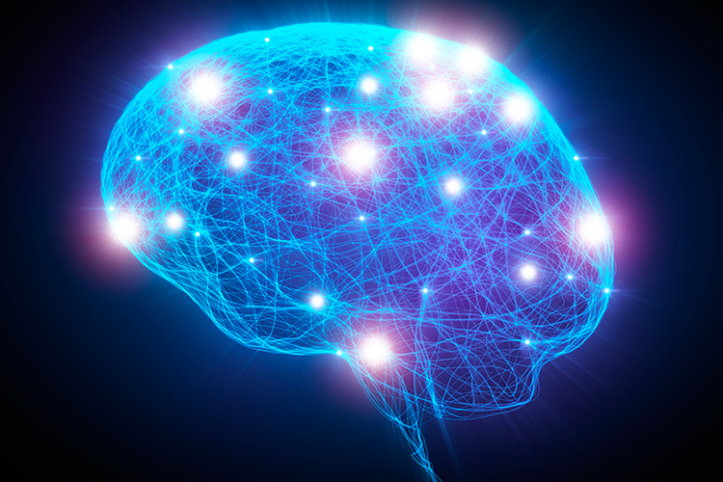

Artificial Neural Networks (ANNs)
Computing systems inspired by the biological neural networks that constitute animal brains

Slide 3
Biological Inspirations
Some numbers
The human brain contains about 10,000,000,000 (10B) nerve cells (neurons)
Each neuron is connected to the others through 10,000 synapses
Properties of the brain
It can learn, reorganize itself from experience
It adapts to the environment
It is robust and fault tolerant

Slide 4
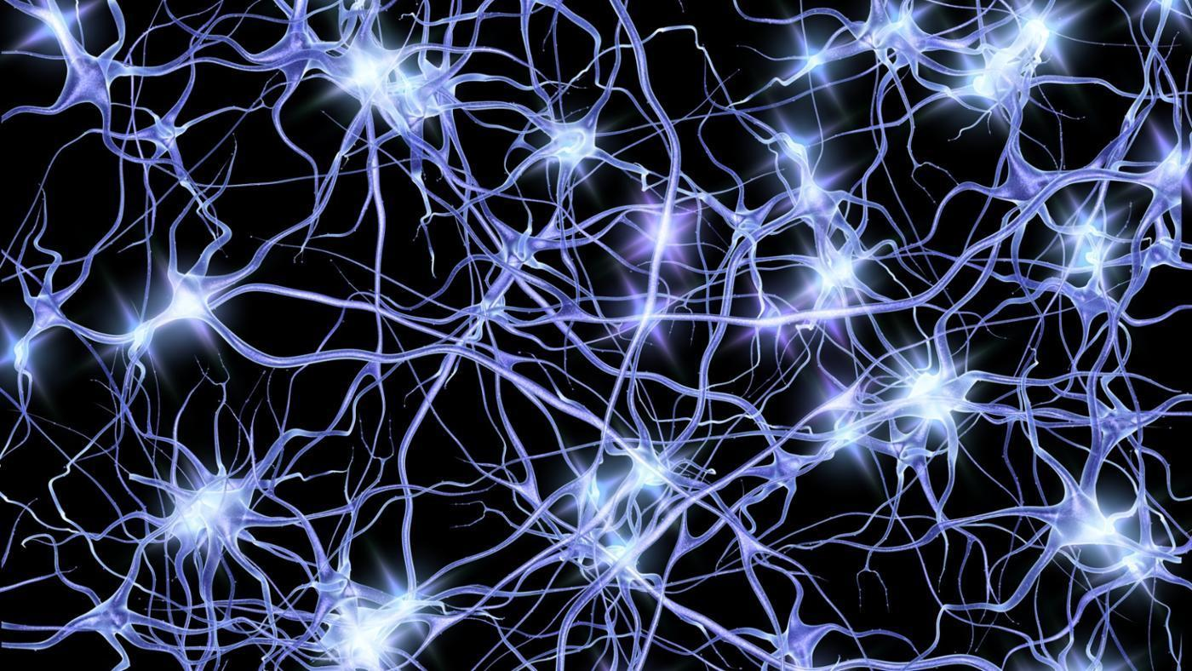
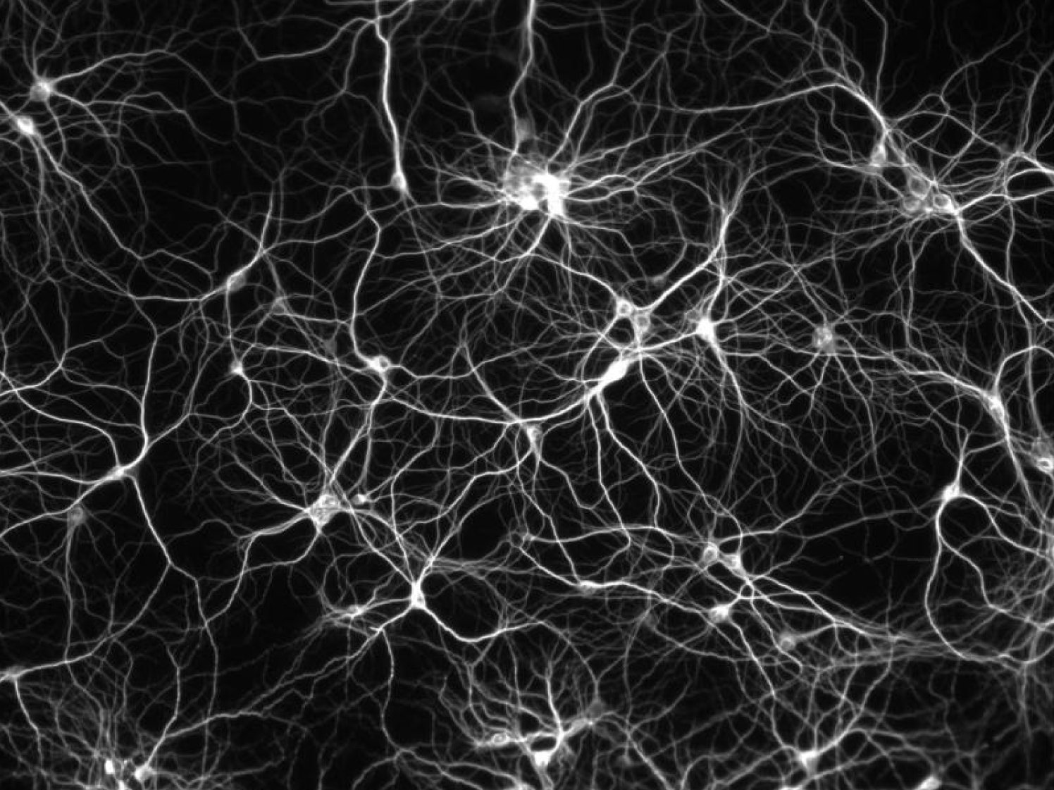
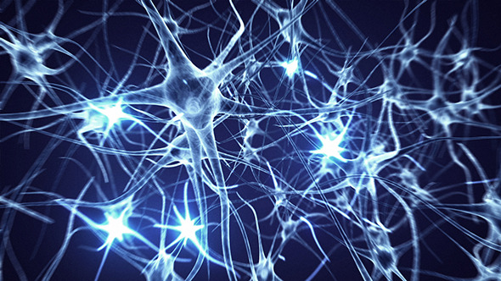

Neurons
Started by psychologists and neurobiologists to develop and test computational analogues of neurons
Structure of Neuron:

Slide 5
Neurons (cont.)
A neuron has
A branching input (dendrites)
A branching output (the axon)
The information/signal circulates from the dendrites to the axon via the cell body
Structure of Neuron:
Signal

Slide 6
Neurons for Classification
A neuron has
A branching input (dendrites)
A branching output (the axon)
The information/signal circulates from the dendrites to the axon via the cell body
feature-label relationship
Structure of Neuron:
Label of a data point
Feature values of a data point

Slide 7
Artificial Neuron
Definition: Non-linear, parameterized function with restricted output range
An n-dimensional input vector x is mapped into variable y by means of the scalar product and a nonlinear function mapping
Bias
b
x₁
w₁
Activation
function
Output
(label)
y
Input
signal
(features)
x₂
w₂
Summing
function
x_{m}
w_{m}
Synaptic
weights

Slide 8
Artificial Neuron (cont.)
It is the basic information processing unit of an ANN.
The inputs are multiplied by their corresponding weights to form a weighted sum, which is added to the bias associated with unit. Then a nonlinear activation function is applied to it.
Bias
b
x₁
w₁
Activation
function
Output
(label)
y
Input
signal
(features)
x₂
w₂
Summing
function
x_{m}
w_{m}
Synaptic
weights

Slide 9
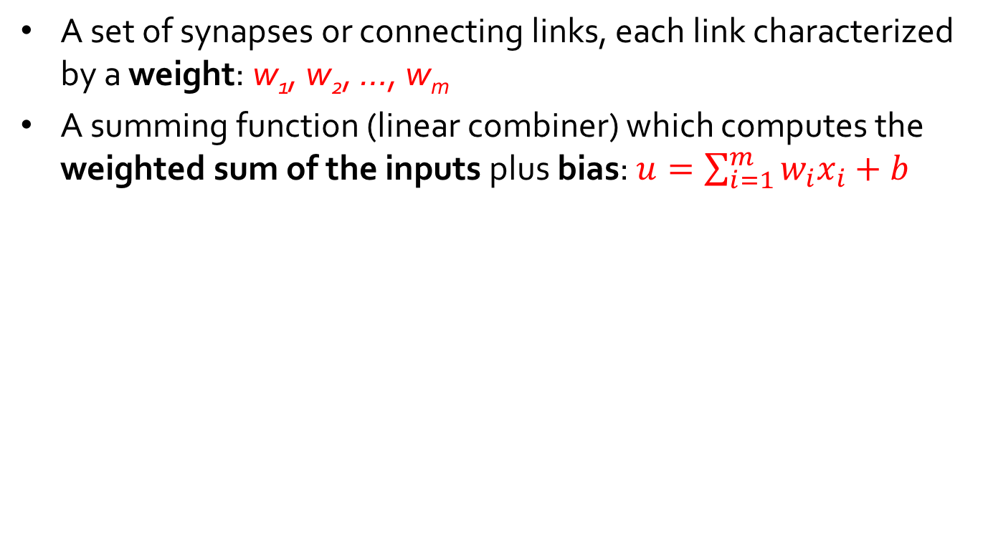
Artificial Neuron (cont.)
A set of synapses or connecting links, each link characterized by a weight: w₁, w₂, …, w_{m}
A summing function (linear combiner) which computes the weighted sum of the inputs plus bias: $u=\sum_{i=1}^{m}{w_{i}x_{i}}+b$
Bias
b
x₁
w₁
Activation
function
Output
(label)
y
u
Input
signal
(features)
x₂
w₂
Summing
function
x_{m}
w_{m}
Synaptic
weights

Slide 10
Artificial Neuron (cont.)
Activation function (squashing function) 𝞅: u → y for limiting the amplitude of the output of the neuron
E.g., Logistic functions (including Sigmoid function), Hyperbolic tangent function
Bias
b
x₁
w₁
Activation
function
Output
(label)
y
u
Input
signal
(features)
x₂
w₂
Summing
function
x_{m}
w_{m}
Synaptic
weights

Slide 11
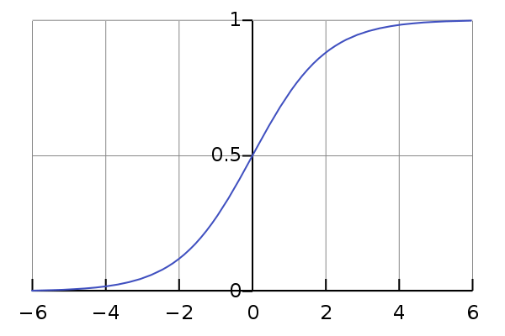
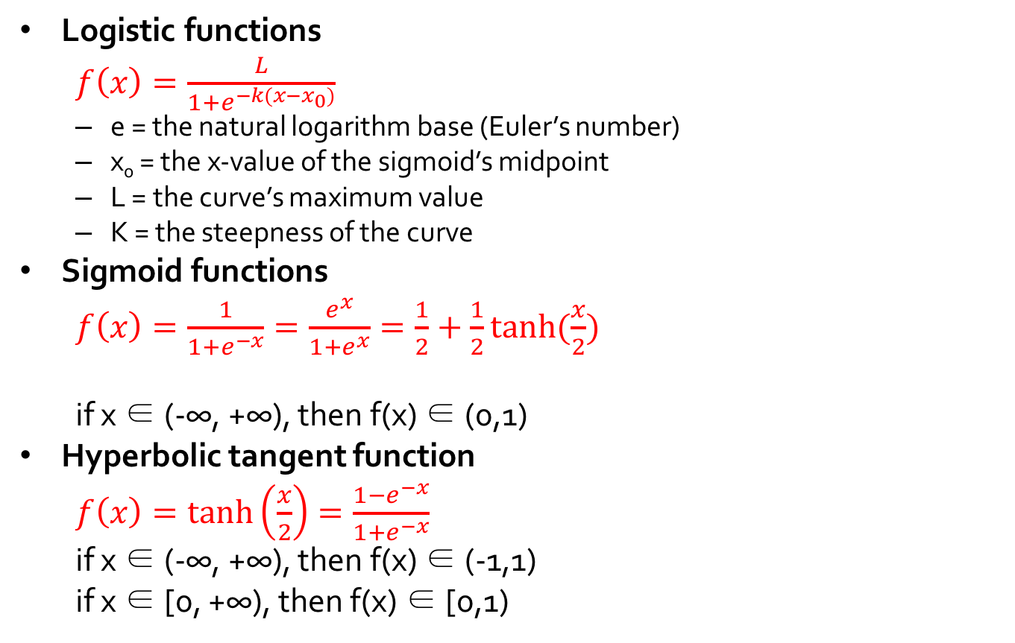
Activation Function: an “S” shape
Logistic functions
$f\left(x\right)=\frac{L}{1+e^{−k(x−x_{0})}}$
e = the natural logarithm base (Euler’s number)
x₀ = the x-value of the sigmoid’s midpoint
L = the curve’s maximum value
K = the steepness of the curve
Sigmoid functions
$f\left(x\right)=\frac{1}{1+e^{−x}}=\frac{e^{x}}{1+e^{x}}=\frac{1}{2}+\frac{1}{2}tanh⁡(\frac{x}{2})$
if x ∈ (-∞, +∞), then f(x) ∈ (0,1)
Hyperbolic tangent function
$f\left(x\right)=\tanh\left(\frac{x}{2}\right)=\frac{1−e^{−x}}{1+e^{−x}}$
if x ∈ (-∞, +∞), then f(x) ∈ (-1,1)
if x ∈ [0, +∞), then f(x) ∈ [0,1)
L = 1, k = 1, x₀ = 0

Slide 12
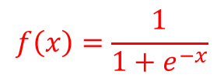
Artificial Neuron: An Example
weights = [3.0, -0.5, -2.5, 1.5], b = -0.1
Is KDD?
 | “data mining” | “web search” | “click through rate” | “pattern” | Label | Output
PID1 | 1 | 0 | 0 | 1 | 1 | f(4.4)
PID2 | 0 | 1 | 1 | 0 | 0 | f(-3.1)
PID3 | 1 | 1 | 0 | 1 | 1 | f(3.9)
Bias
b
x₁
w₁
Activation
function
Output
(label)
y
Input
signal
(features)
x₂
w₂
Summing
function
$$f\left(x\right)=\frac{1}{1+e^{−x}}$$
x_{m}
w_{m}
Synaptic
weights

Slide 13
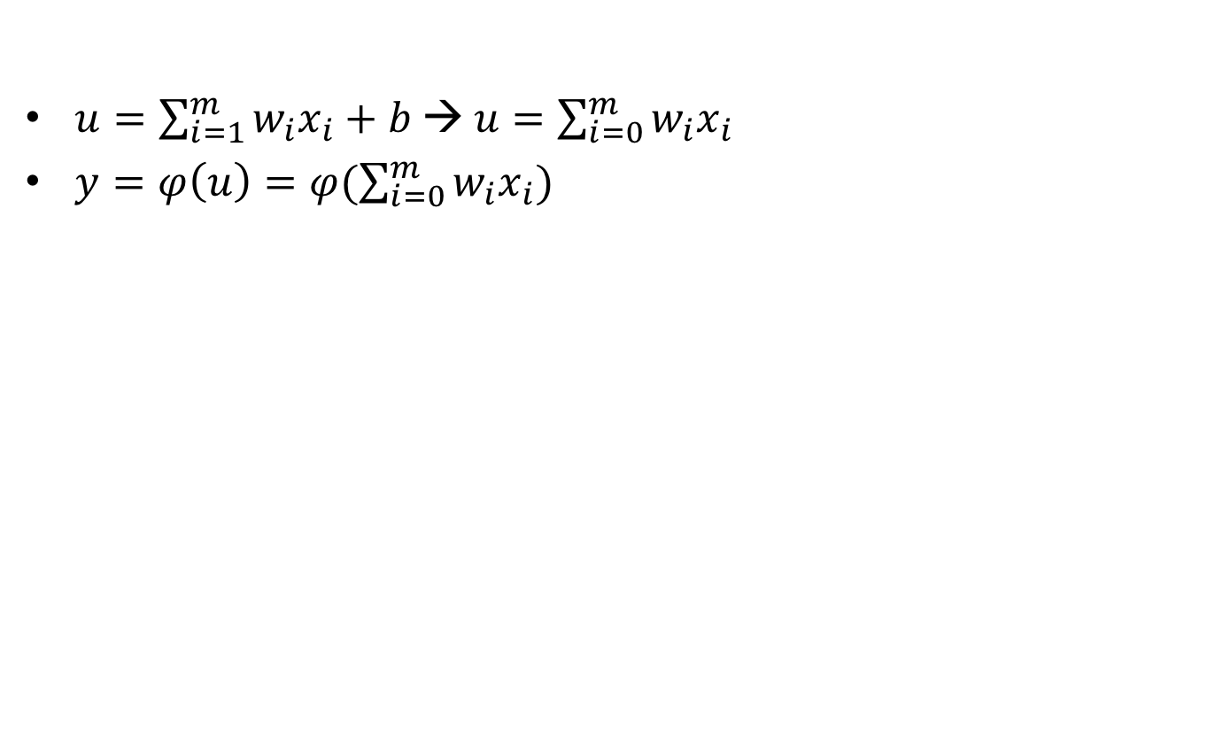
Bias
$u=\sum_{i=1}^{m}{w_{i}x_{i}}+b$ → $u=\sum_{i=0}^{m}{w_{i}x_{i}}$
$y=φ\left(u\right)=φ(\sum_{i=0}^{m}{w_{i}x_{i}})$
x₀=+1
w₀=b
Bias
b
x₁
w₁
Activation
function
Output
(label)
y
Input
signal
(features)
x₂
w₂
Summing
function
$$f\left(x\right)=\frac{1}{1+e^{−x}}$$
x_{m}
w_{m}
Synaptic
weights

Slide 14
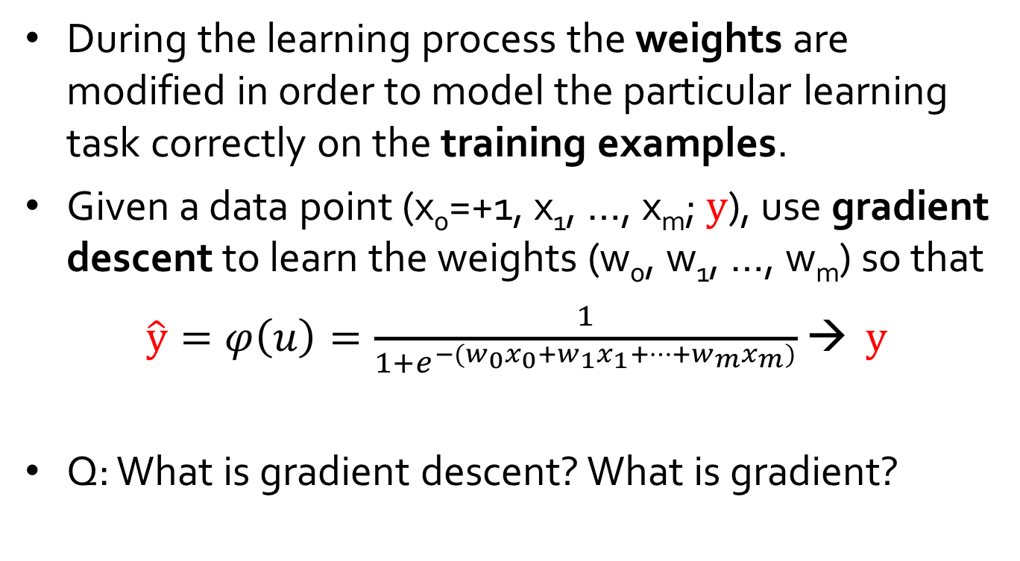
Learning Process
During the learning process the weights are modified in order to model the particular learning task correctly on the training examples.
Given a data point (x₀=+1, x₁, …, x_{m}; $y$), use gradient descent to learn the weights (w₀, w₁, …, w_{m}) so that
$\hat{y}=φ\left(u\right)=\frac{1}{1+e^{−(w_{0}x_{0}+w_{1}x_{1}+⋯+w_{m}x_{m})}}$ → $y$
Q: What is gradient descent? What is gradient?
This is actually Logistic Regression!

Slide 15
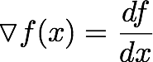
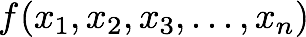
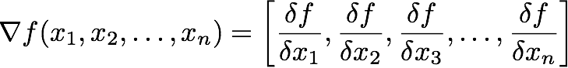
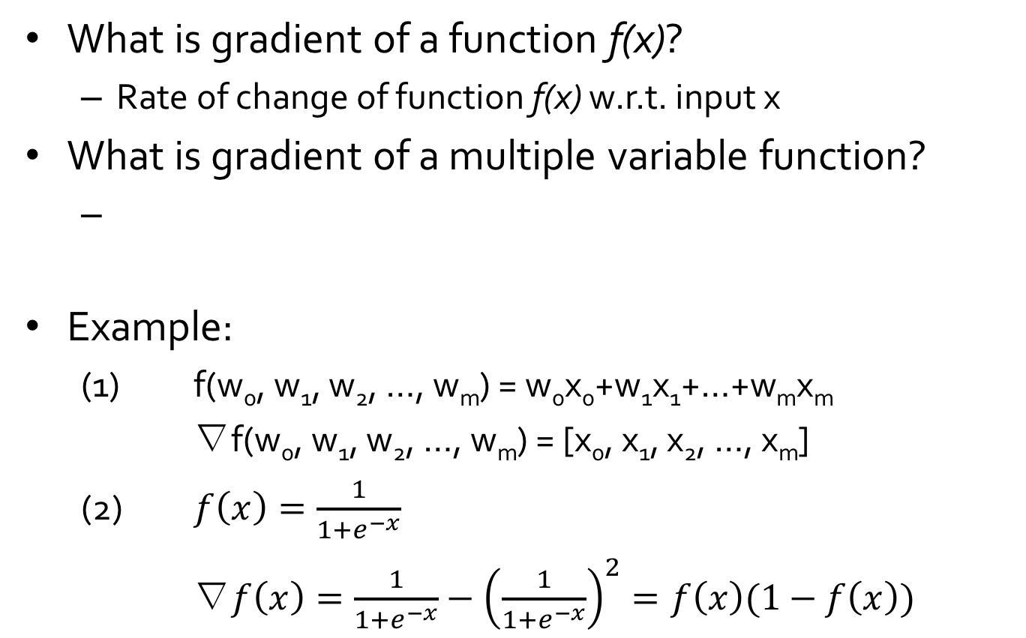
Gradient
What is gradient of a function f(x)?
Rate of change of function f(x) w.r.t. input x
What is gradient of a multiple variable function?
Example:
(1) f(w₀, w₁, w₂, …, w_{m}) = w₀x₀+w₁x₁+…+w_{m}x_{m}
∇f(w₀, w₁, w₂, …, w_{m}) = [x₀, x₁, x₂, …, x_{m}]
(2) $f\left(x\right)=\frac{1}{1+e^{−x}}$
∇$f\left(x\right)=\frac{1}{1+e^{−x}}−{\left(\frac{1}{1+e^{−x}}\right)}^{2}=f\left(x\right)(1−f\left(x\right))$

Slide 16
Gradient Descent
Gradient descent is a first-order iterative optimization algorithm for finding the minimum of a function.
To find a local minimum of a function using gradient descent, one takes steps proportional to the negative of the gradient (or of the approximate gradient) of the function at the current point.
If instead one takes steps proportional to the positive of the gradient, one approaches a local maximum of that function; the procedure is then known as gradient ascent.

Slide 17
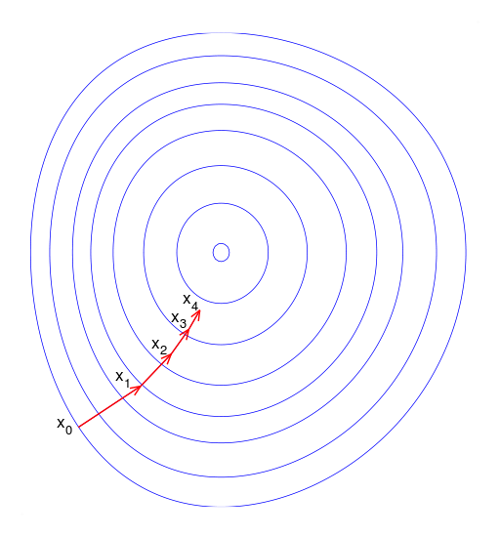
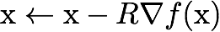
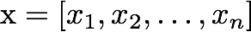
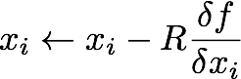
Gradient Descent (cont.)
Gradient: direction of steepest increase
Magnitude: rate of change in that direction
Local minimum: go in the reverse direction
where
local maximum
max f
gradient

Slide 18

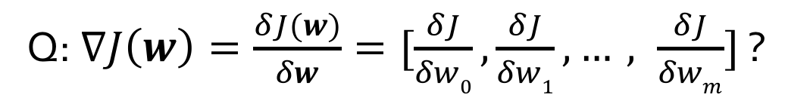
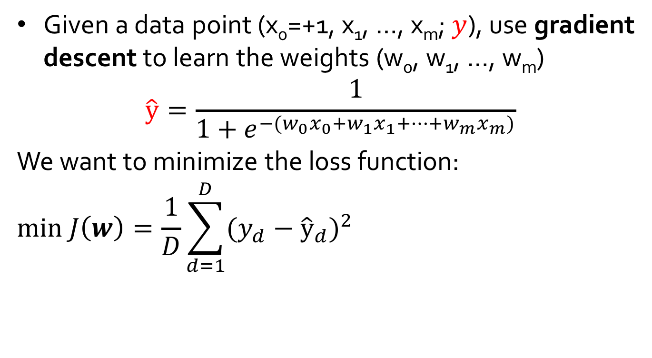
Gradient Descent for a Single Neuron
Given a data point (x₀=+1, x₁, …, x_{m}; $y$), use gradient descent to learn the weights (w₀, w₁, …, w_{m})
$$\hat{y}=\frac{1}{1+e^{−(w_{0}x_{0}+w_{1}x_{1}+⋯+w_{m}x_{m})}}$$
We want to minimize the loss function:
$$min J\left(w\right)=\frac{1}{D}\sum_{d=1}^{D}{{({y_{d}−\hat{y}}_{d})}^{2}}$$
Q: $∇J\left(w\right)=\frac{δJ(w)}{δw}=[\frac{δJ}{δw0},\frac{δJ}{δw1},…, \frac{δJ}{δwm}]$ ?

Slide 19


Slide 20
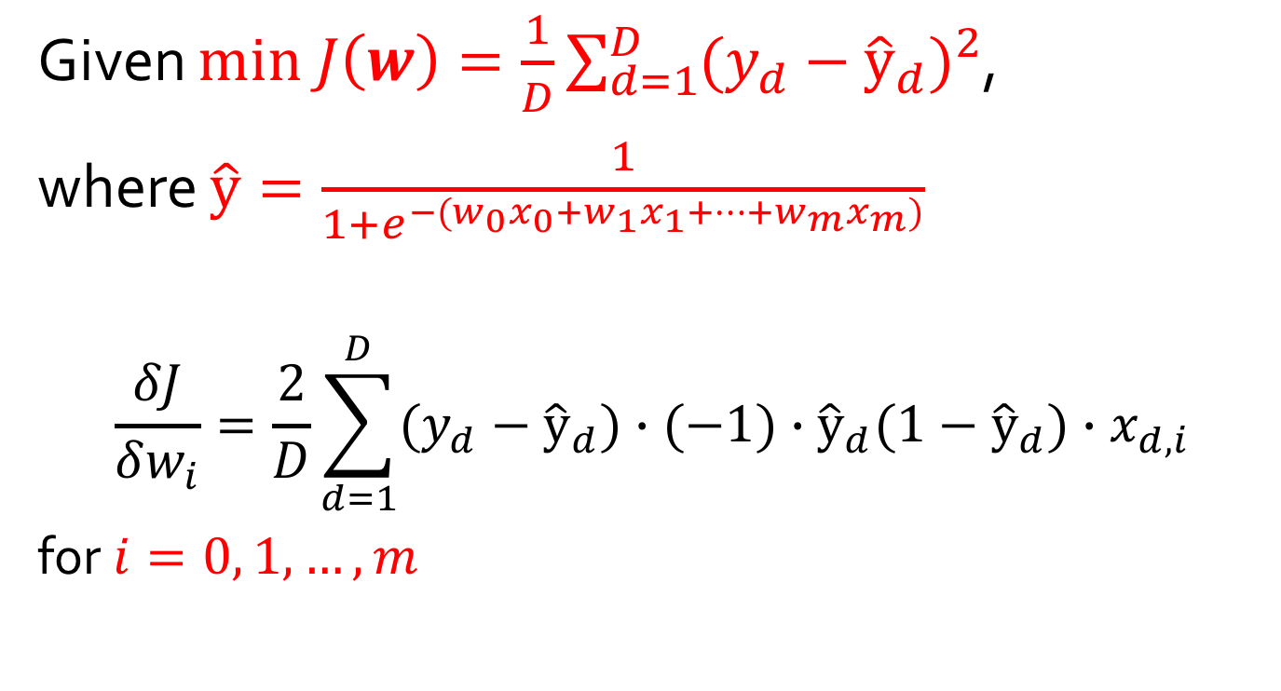
Partial Derivatives
Given $min J\left(w\right)=\frac{1}{D}\sum_{d=1}^{D}{{(y_{d}−{\hat{y}}_{d})}^{2}}$,
where $\hat{y}=\frac{1}{1+e^{−(w_{0}x_{0}+w_{1}x_{1}+⋯+w_{m}x_{m})}}$
$$\frac{δJ}{δw_{i}}=\frac{2}{D}\sum_{d=1}^{D}{(y_{d}−{\hat{y}}_{d})∙(−1)∙{\hat{y}}_{d}(1−{\hat{y}}_{d})∙x_{d,i}}$$
for $i=0, 1,…, m$

Slide 21
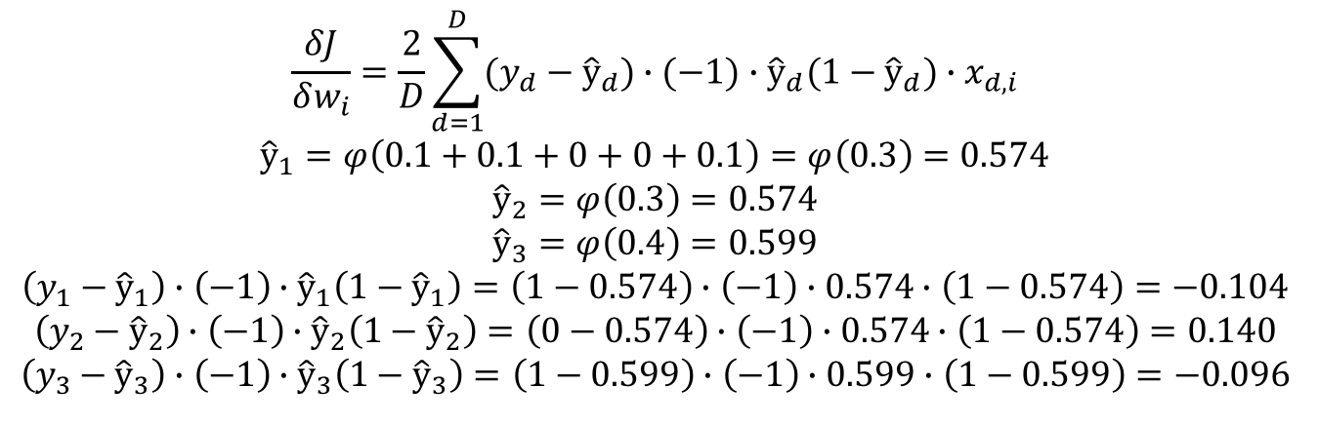
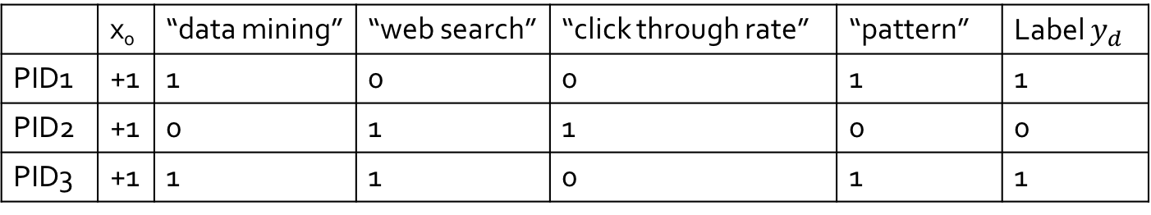
Example
Initialized weights = [0.1, 0.1, 0.1, 0.1, 0.1]
 | x₀ | “data mining” | “web search” | “click through rate” | “pattern” | Label $y_{d}$
PID1 | +1 | 1 | 0 | 0 | 1 | 1
PID2 | +1 | 0 | 1 | 1 | 0 | 0
PID3 | +1 | 1 | 1 | 0 | 1 | 1
$$\frac{δJ}{δw_{i}}=\frac{2}{D}\sum_{d=1}^{D}{(y_{d}−{\hat{y}}_{d})∙(−1)∙{\hat{y}}_{d}(1−{\hat{y}}_{d})∙x_{d,i}}$$
$${\hat{y}}_{1}=φ\left(0.1+0.1+0+0+0.1\right)=φ\left(0.3\right)=0.574$$
$${\hat{y}}_{2}=φ\left(0.3\right)=0.574$$
$${\hat{y}}_{3}=φ\left(0.4\right)=0.599$$
$$\left(y_{1}−{\hat{y}}_{1}\right)∙\left(−1\right)∙{\hat{y}}_{1}\left(1−{\hat{y}}_{1}\right)=\left(1−0.574\right)∙\left(−1\right)∙0.574∙\left(1−0.574\right)=−0.104$$
$$\left(y_{2}−{\hat{y}}_{2}\right)∙\left(−1\right)∙{\hat{y}}_{2}\left(1−{\hat{y}}_{2}\right)=\left(0−0.574\right)∙\left(−1\right)∙0.574∙\left(1−0.574\right)=0.140$$
$$\left(y_{3}−{\hat{y}}_{3}\right)∙\left(−1\right)∙{\hat{y}}_{3}\left(1−{\hat{y}}_{3}\right)=\left(1−0.599\right)∙\left(−1\right)∙0.599∙\left(1−0.599\right)=−0.096$$

Slide 22
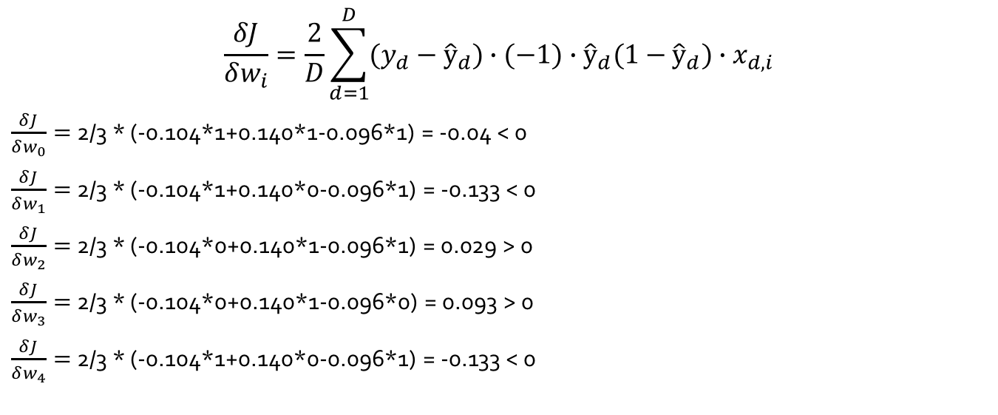
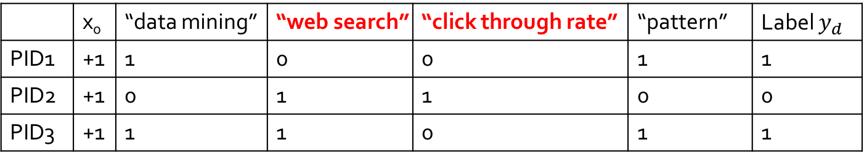
Example (cont.)
Initialized weights = [0.1, 0.1, 0.1, 0.1, 0.1]
 | x₀ | “data mining” | “web search” | “click through rate” | “pattern” | Label $y_{d}$
PID1 | +1 | 1 | 0 | 0 | 1 | 1
PID2 | +1 | 0 | 1 | 1 | 0 | 0
PID3 | +1 | 1 | 1 | 0 | 1 | 1
$$\frac{δJ}{δw_{i}}=\frac{2}{D}\sum_{d=1}^{D}{(y_{d}−{\hat{y}}_{d})∙(−1)∙{\hat{y}}_{d}(1−{\hat{y}}_{d})∙x_{d,i}}$$
$\frac{δJ}{δw_{0}}=$ 2/3 * (-0.104*1+0.140*1-0.096*1) = -0.04 < 0
$\frac{δJ}{δw_{1}}=$ 2/3 * (-0.104*1+0.140*0-0.096*1) = -0.133 < 0
$\frac{δJ}{δw_{2}}=$ 2/3 * (-0.104*0+0.140*1-0.096*1) = 0.029 > 0
$\frac{δJ}{δw_{3}}=$ 2/3 * (-0.104*0+0.140*1-0.096*0) = 0.093 > 0
$\frac{δJ}{δw_{4}}=$ 2/3 * (-0.104*1+0.140*0-0.096*1) = -0.133 < 0
If the learning rate (magnitude) is 1.0,
new weights =
[0.14, 0.233, 0.071, 0.007, 0.233]

Slide 23

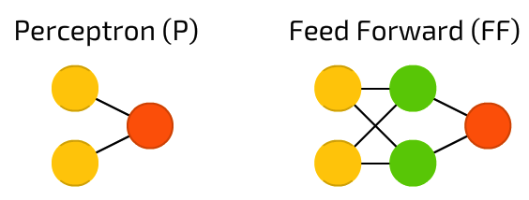


Hidden Layer of Neurons
Input: data points of n=2 features
Output: one label
Each hidden cell (neuron)’s output is a new feature (that is a non-linear function result of old features) as input for the output cell.

Slide 24
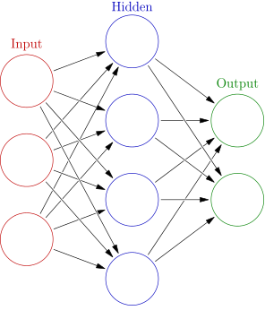
Can we have multiple output cells? Yes! A Three-Layer Feed-Forward Neural Network
Output vector
Output layer
Hidden layer
w_{ij}
Input layer
Input vector: X
Q: How many weight parameters?
This is a 2-3-3 ANN.
This is a 3-4-2 ANN.
2*3+3*3 = 15
3*4+4*2 = 20
Q’: How many weight parameters did we have in an SVM?

Slide 25
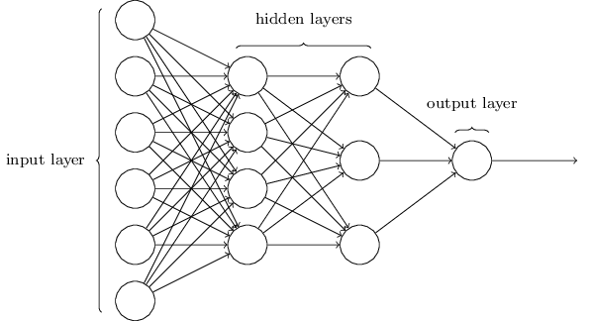
Can we have multiple hidden layers? Yes! A Two-Hidden-Layer Feed-Forward Neural Network
Suppose we have one hidden layer of 7 neurons. It is a 6-7-1 network.
We have 6*7+7*1 = 49 weight parameters to learn.
Here we have two hidden layers (4+3). It is a 6-4-3-1 network.
We have 6*4+4*3+3*1 = 39 weight parameters to learn.
When the network’s architecture becomes more complicated, the number of parameters may NOT become more, but the performance may become better:
It can model more complicated non-linear distributions.

Slide 26
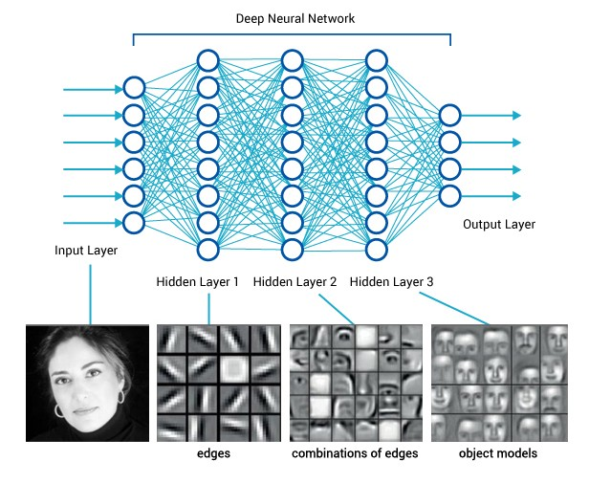
Deep Neural Networks
One of the main deep learning architectures.

Slide 27

Deep Neural Networks (cont.)
How many layers is a DEEP network architecture?

Slide 28
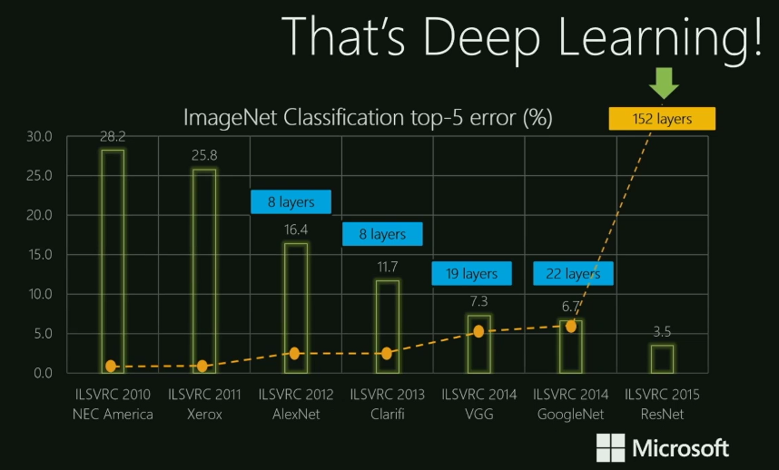

Slide 29
Summary: Components of a Feed-Forward Neural Network
The inputs to the network correspond to the attributes measured for each training tuple
Inputs are fed simultaneously into the units making up the input layer
They are then weighted and fed simultaneously to a hidden layer
The number of hidden layers is arbitrary
The weighted outputs of the last hidden layer are input to units making up the output layer, which emits the network's prediction
The network is feed-forward: None of the weights cycles back to an input unit or to an output unit of a previous layer
From a statistical point of view, networks perform nonlinear regression
Given enough hidden units and enough training samples (and enough what?), they can closely approximate any function

Slide 30
Limitations of Neural Networks
Random initialization + densely connected networks lead to:
High cost
Training the entire neural network is to train all the interconnected logistic regressions.
Difficult to train as the number of hidden layers increases
Recall that logistic regression is trained by gradient descent that is looking for local optimum.
Stuck in local optima
The objective function of the neural network is usually not convex.
The random initialization does not guarantee starting from the proximity of global optima.
Difficult to determine the network topology
Once a network has been trained and its accuracy is unacceptable, repeat the training process with a different network topology or a different set of initial weights.

Slide 31
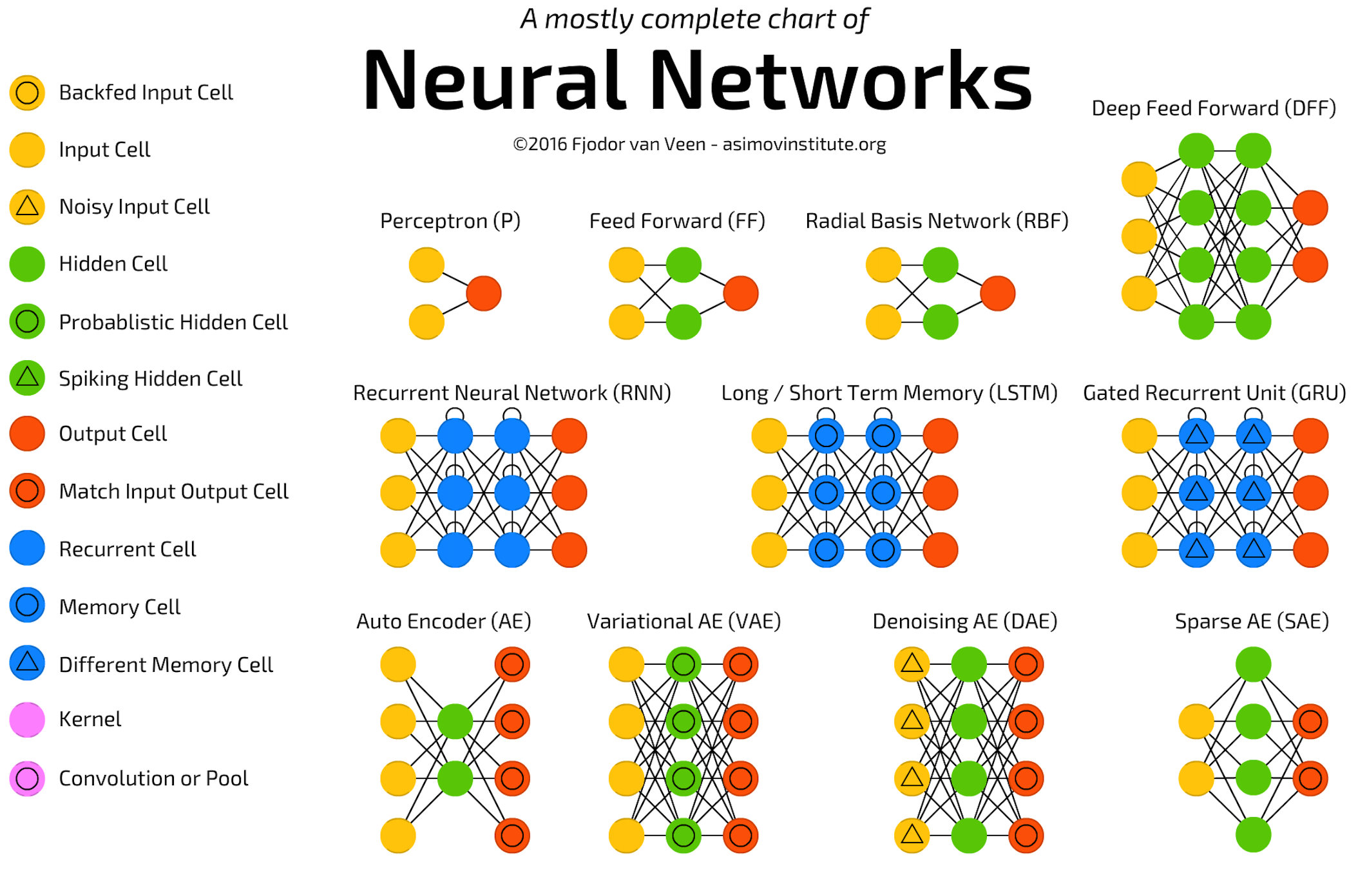
Beyond Input/Hidden/Output Cells and Beyond Feed-Forward Network Architectures
directed circle, memory, sequences

Slide 32
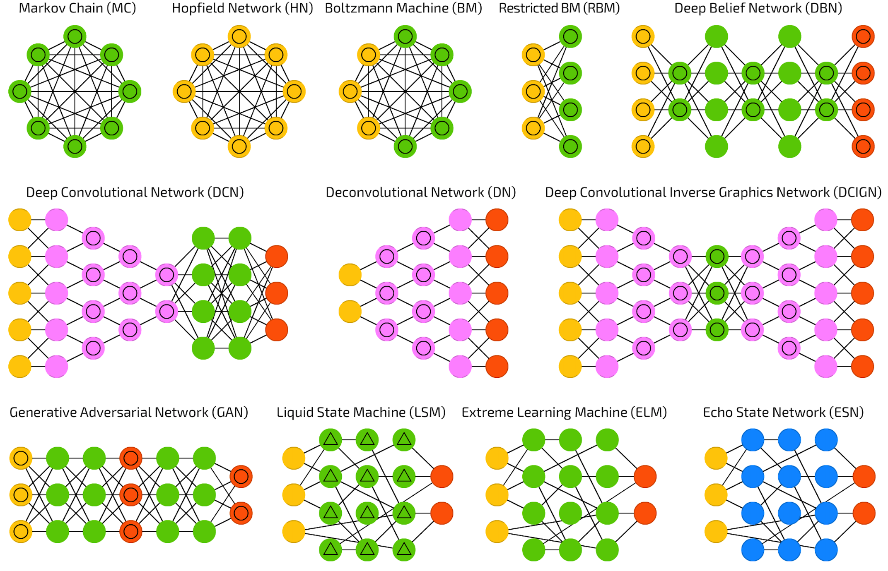
Continue…
feed-forward, pooling layers, max/avg.
generative, discriminative, error rate

Slide 33
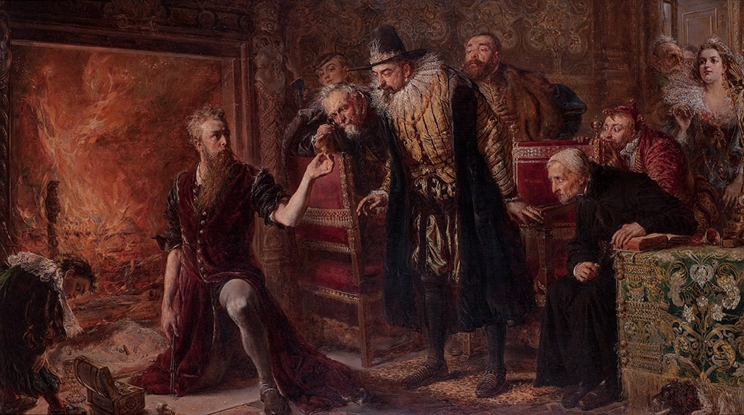
More Details on RNNs, CNNs, GANs?
Please register Machine Learning course by Prof. Nitesh Chawla in Spring’18.
Our Data Science is a prerequisite for his class.
Deep Learning and Alchemy?

